Slide 1
Shell Bootcamp 2024 3 Reflections for Week #2
Shatakshi Shree
Date : 6-Sept-2024

Slide 2

About Me
You either be as you seem or seem as you are. There is only one life, do your best and stand out. Spread happiness.

Slide 3

My learnings from this week!

Slide 4
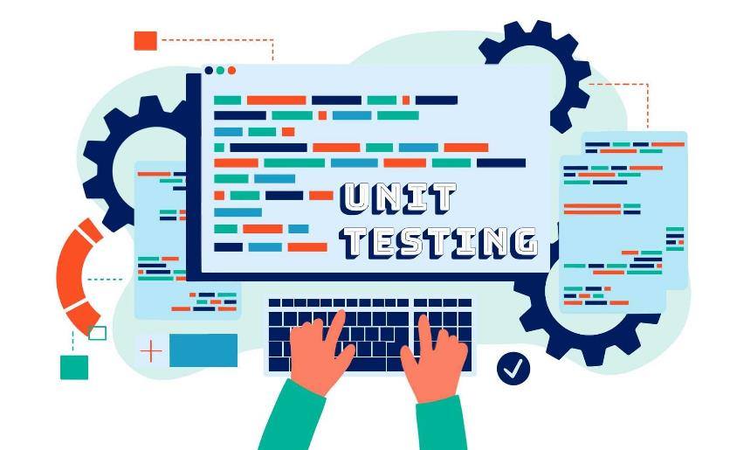
Learning 1 | My takeaways
Unit testing and Test-Driven Development (TDD) are essential practices in software development that enhance code quality and reliability. Unit testing involves writing tests for individual functions or methods to ensure they work correctly, offering benefits like early bug detection and improved code quality. TDD, on the other hand, involves writing tests before the actual code, following a cycle of writing a failing test, making it pass, and then refactoring the code. This approach helps developers understand requirements better, reduces debugging time, and ensures new changes do not break existing functionality. In the DevOps realm, Continuous Integration (CI) and Continuous Delivery (CD) streamline the software development lifecycle. CI involves frequent code integrations into a shared repository with automated builds and tests, promoting early issue detection and improved collaboration. CD ensures code changes are automatically tested and prepared for release, reducing deployment risks and enabling faster releases. Continuous Deployment extends CD by automatically deploying every change that passes tests to production, ensuring immediate updates and increased efficiency. Both CI and CD emphasize automation, collaboration, and continuous improvement, integral to the DevOps culture.

Slide 5
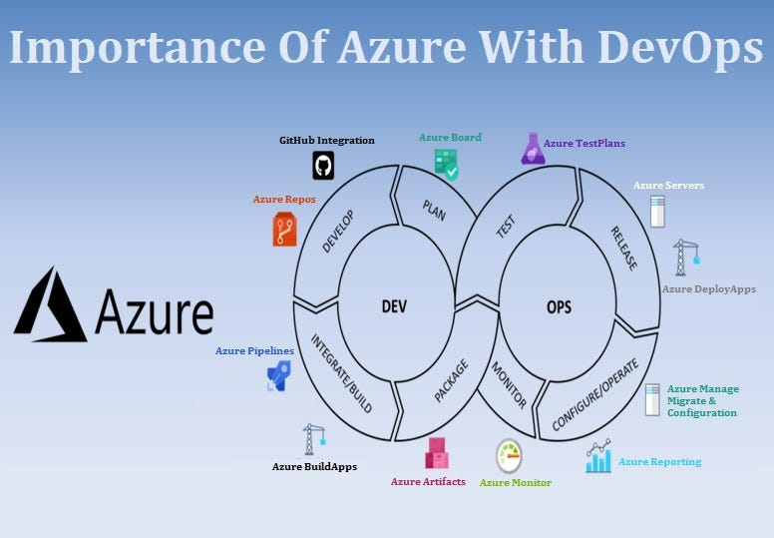
Learning 2 | My takeaways
Microsoft Azure is a comprehensive cloud computing platform that offers a wide range of services, enabling businesses to build, deploy, and manage applications through Microsoft's global network of data centers. Key takeaways from an introduction to Azure include its core services and benefits. Azure provides Infrastructure as a Service (IaaS), Platform as a Service (PaaS), and Software as a Service (SaaS), catering to various business needs. It supports multiple programming languages, frameworks, and tools, making it versatile for developers. Azure's scalability allows businesses to scale resources up or down based on demand, ensuring cost efficiency. Additionally, Azure emphasizes security with features like multi-factor authentication, advanced threat detection, and compliance with global standards. The platform also integrates seamlessly with existing Microsoft products, enhancing productivity and collaboration. Overall, Azure's robust infrastructure, extensive service offerings, and strong security measures make it a powerful choice for organizations looking to leverage cloud computing.

Slide 6
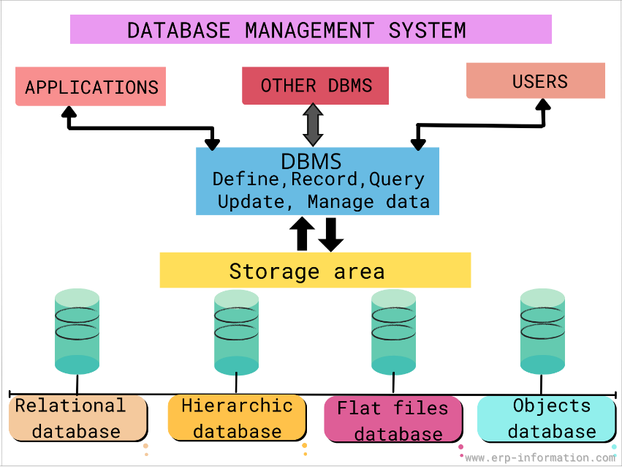
Learning 3 | My takeaways
PostgreSQL is a powerful, open-source relational database management system (RDBMS) known for its extensibility and SQL compliance. It supports both SQL and JSON querying, making it versatile for various applications. Key features include ACID compliance, multi-version concurrency control (MVCC), and the ability to define custom data types and functions. An RDBMS, like PostgreSQL, organizes data into tables with rows and columns, ensuring data integrity and consistency through relational constraints and transaction management. It is essential for handling structured data efficiently, supporting complex queries, and maintaining data relationships. A Database Management System (DBMS) is broader, encompassing software that manages databases, providing functionalities like data storage, retrieval, and security. While a DBMS can handle various data models, an RDBMS specifically uses a relational model to manage data. Together, these systems are crucial for modern data management, enabling efficient, secure, and scalable data operations.

Slide 7

Relevance of learnings for my organization

Slide 8

Learning 1 | Relevance for Shell
For Shell, unit testing and Test-Driven Development (TDD) are crucial for ensuring the reliability and quality of their complex software systems. Unit testing verifies the functionality of individual components, while TDD promotes robust and maintainable code by requiring tests before code development. These practices help in early bug detection and reduce debugging time, ensuring that new changes do not disrupt existing functionality. In the DevOps realm, Continuous Integration (CI) and Continuous Delivery (CD) streamline Shell's software development lifecycle. CI involves frequent code integrations with automated builds and tests, improving collaboration and early issue detection. CD automates the deployment process, enabling faster, more reliable software updates and reducing deployment risks. Together, these practices support Shell's goal of delivering high-quality software efficiently and consistently, enhancing overall operational efficiency.

Slide 9
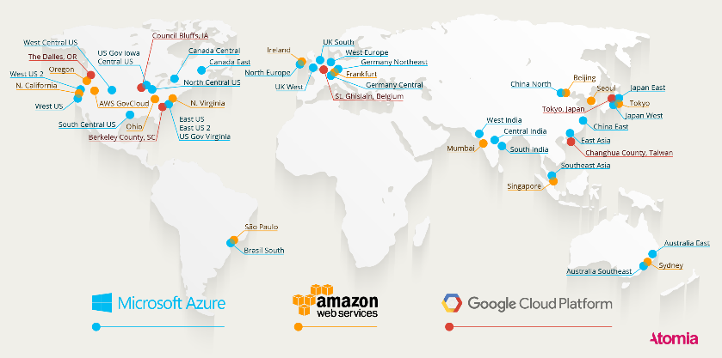
Learning 2 | Relevance for Shell
For Shell, leveraging Microsoft Azure's cloud platform offers significant advantages in terms of scalability, security, and operational efficiency. Azure provides robust infrastructure-as-a-service (IaaS) and platform-as-a-service (PaaS) solutions, enabling Shell to efficiently manage and scale its applications and data. The platform's advanced security features, including multi-factor authentication and compliance with global standards, ensure the protection of sensitive data. Azure's integration capabilities with existing Microsoft products enhance productivity and collaboration across Shell's global operations. Additionally, Azure's extensive analytics and AI services can support Shell in optimizing its operations, improving decision-making, and driving innovation in energy management and sustainability initiatives.

Slide 10
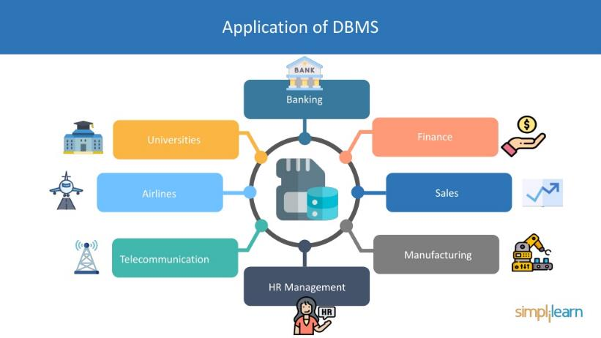
Learning 3 | Relevance for Shell
For Shell, utilizing a robust Database Management System (DBMS) like PostgreSQL is highly beneficial. PostgreSQL, an advanced open-source relational database management system (RDBMS), offers reliability, scalability, and extensibility, which are crucial for managing Shell's vast and complex data. Its support for ACID transactions ensures data integrity and consistency, vital for Shell's operations. PostgreSQL's ability to handle complex queries and diverse data types, including JSON, makes it versatile for various applications, from real-time analytics to IoT data management. Additionally, its strong community support and continuous development provide Shell with a secure and up-to-date database solution, enhancing operational efficiency and enabling innovative data-driven.

Slide 11

Challenges in implementing learning

Slide 12

Challenge faced while implementing Learning 1
Learning and implementing unit testing, TDD, and DevOps practices like CI/CD at Shell can present several challenges. For unit testing and TDD, we faced a steep learning curve, resistance to change from traditional development methods, and difficulties in writing effective tests that cover all scenarios. Additionally, maintaining a balance between writing tests and implementing functionality can be daunting. In the realm of DevOps, challenges include cultural resistance to adopting new practices, the complexity of integrating various tools, and ensuring consistent environment provisioning. Overcoming these hurdles requires comprehensive training, fostering a collaborative culture, and investing in automation tools to streamline processes.

Slide 13

Challenge faced while implementing Learning 2
Learning and implementing Azure cloud for Shell can present several challenges. First, the complexity of migrating existing systems to Azure can be daunting, requiring significant planning and expertise. Additionally, ensuring data security and compliance with industry regulations is critical, necessitating robust security measures and continuous monitoring. The learning curve for Azure’s extensive range of services and tools can be steep, demanding comprehensive training for Shell’s IT staff. Integration with existing on-premises systems and other cloud services can also pose technical difficulties. Finally, managing costs effectively while scaling resources to meet dynamic business needs requires careful financial planning and monitoring. Overcoming these challenges involves strategic planning, investment in training, and leveraging Azure’s support and best practices

Slide 14
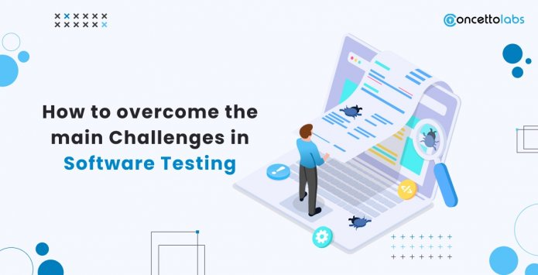
Challenge faced while implementing Learning 3
Learning and implementing a Database Management System (DBMS) like PostgreSQL at Shell can present several challenges. First, the complexity of migrating existing data and systems to a new DBMS requires meticulous planning and expertise. Ensuring data security and compliance with industry regulations is critical, necessitating robust security measures and continuous monitoring. The learning curve for mastering DBMS features and best practices can be steep, demanding comprehensive training for Shell's IT staff. Additionally, integrating the DBMS with existing on-premises systems and other cloud services can pose technical difficulties. Managing database performance and scalability as data volumes grow is another significant challenge, requiring ongoing optimization and resource management. Overcoming these hurdles involves strategic planning, investment in training, and leveraging best practices and support from the DBMS.

Slide 15

Action Plan

Slide 16
My Action Plan for this Week
Actions
Timeline
Status
Practicing skills learnt till date that are Behavioural skills, BA & Agile and DBMS, azure cloud, devops
Saturday – Brush up previous week’s concepts
Sunday – Try out epic-story-feature and SQL queries
Completed

Slide 17

Learning is also Fun!

Slide 18
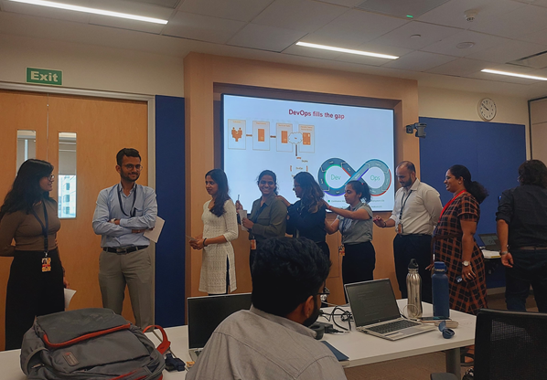
Learning is also Fun!
We played Chinese whisperers to understand that communication is the key to team building.

Slide 19

Summary
Learned topics like software testing TDD, CI & CD, devOps, DBMS
We will begin with department specific training
All the topics are necessary for the company’s work.

Slide 20
Thank You

